Slide 1

Portfolio
PORTFOLIO
AZMINE TOUSHIK WASI
Azmine Toushik Wasi

Slide 2
Azmine Toushik Wasi
Experienced in Programming & IT | Machine Learning & Data Science Explorer | Developer - Writer - Designer
Passionate, hard-working IT professional with good amount of expertise and skills in programming, IT Automation, data science and machine learning, website and mobile application development, graphics design, content writing - designing - marketing, communication. Worked with many startups as well as well-known organizations and companies providing IT and creative support for them. Also a good award winning writer, judge of an international competition, artist, and a good trainer. Love to learn new things, experiment and challenge acquired skills.
Skills :
> Programming: Python (Advanced), C (For contests) > DS & ML : Python (NumPy, Pandas, Matplotlib, Seaborn, Scikitlearn, Keras, Tensorflow, Pycaret), R, SQL > Data Analysis: MS Excel, SAS Analysis and Visualization,Tableau, Power BI > Android App Development: Java, MIT AI > Web Development: HTML, CSS, Wordpress and Elementor > IT: IT Automation, Troubleshooting, Adminmistration & Management of Hardware-Database-Software > Office Software: MS Word, Excel, Access, Powerpoint, Team, Outlook; Google tools

Slide 3
Table of Contents
Udemy Course Analysis --- 4
Data Design --- 5
Findings --- 6
Analysis --- 10
Conclusion - 11

Slide 4
Udemy –Courses Analysis
Present the data on course revenue, and analyzing different topics to understand where opportunities to increase revenue may lie, and track the performance of courses. And, how they will increase their next quarterly earnings.
Data Given:
Udemy Course Data.csv
Reporting to:
Head of Curriculum

Slide 5
Data Design
Data Collecting
Collected Data from given sources
Data Cleaning
1) Remove duplicates
2) Removing blank cells
3) Headers
4) Find and replace
Processing
Created a ‘Date’ Column
Created a column that indicates whether a course is free or paid
a list of the top 20 most subscribed courses with
Their level
Whether they are free or paid,
Whether any are free beginner courses,
Duration of the course
The date they were published
Pivot Tables and Charts
Total number of subscribers for each subject (Pie Chart)
Average number of subscribers for each subject (Bar Chart)
Average cost per subject at each level (Bar Chart)
Average content duration for each subject (Bar Chart)
Average rating per subject for each level (Column Chart)
Any other data that you feel will be important to include in your analysis
Understanding the Problem
Visualising Data with Tableau
Pricing Rating Co-relation
Timeseries analysis of customers and price
Content Duration Analysis

Slide 6
Findings Part 01
Expert level courses of graphics design and musical instruments are generating more money

Slide 7
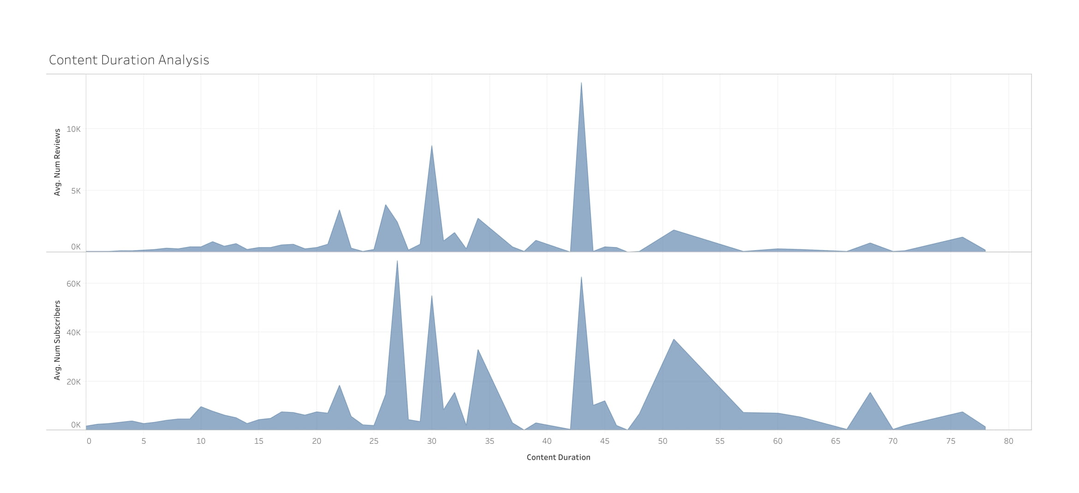
Findings Part 02
Content Length 30 and 43 generates more attraction

Slide 8
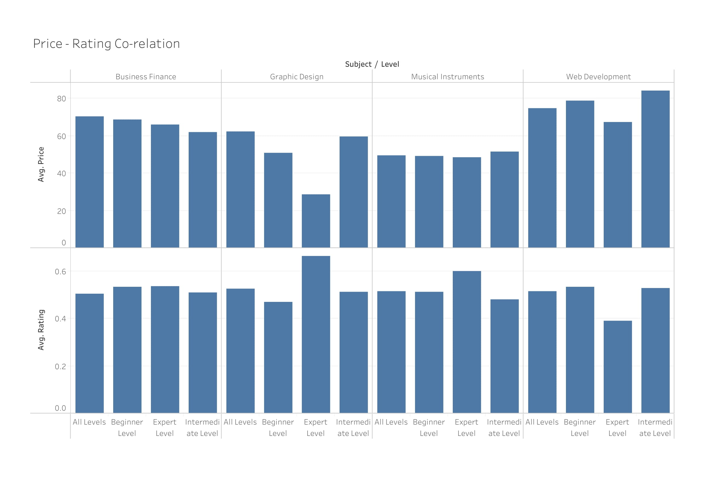
Findings Part 03
Beginner Level Web Development courses are attracting people

Slide 9
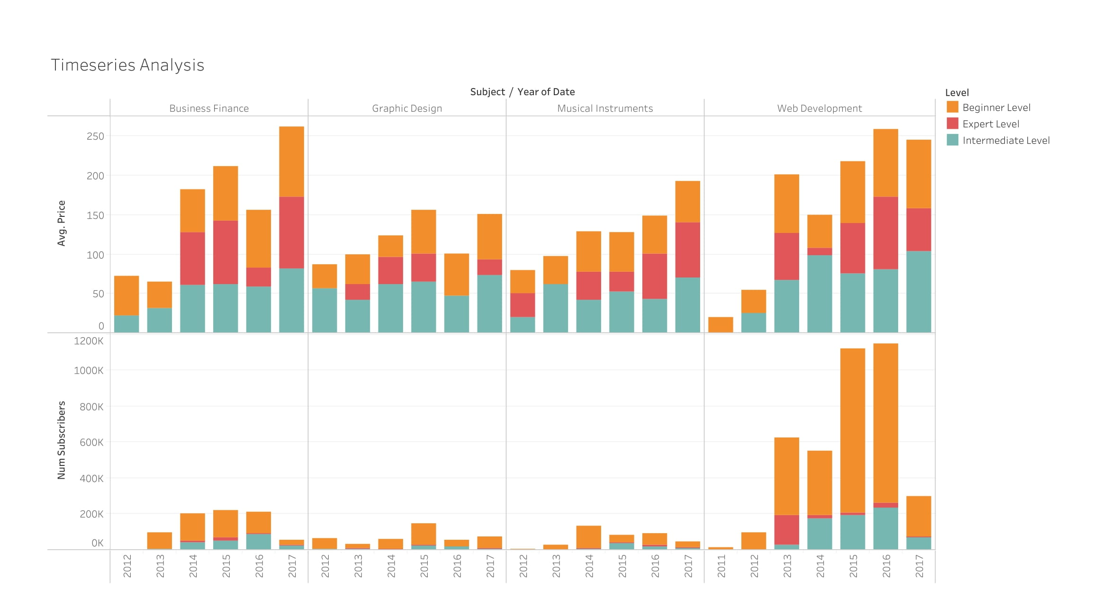
Findings Part 04
Beginner Level Web Development courses are attracting people

Slide 10
Analysis
1
Increasing web development boost due to pandemic
2
Price has a correlation with rating, free courses are generating good rating comparatively.
3
People don’t want much larger content and their most common choice of course length is 42 and 30.

Slide 11
Conclusion
Considering the facts above, we have to promote web development beginner and intermediate courses with big discount, course length should be 30 or 43, as per the findings.

